Slide 1

Week #3
Probability and Statistics
(Software Engineering)
Instructor
Dr. Bakhtawar

Slide 2
Observation and Variable
In statistics, an observation is simply one occurrence of something you’re measuring.
For example, suppose you’re measuring the weight of a certain species of turtle. Each turtle that you collect the weight for counts as one single observation.
The following dataset contains the weight of 15 different turtles, so there are 15 total observations.

Slide 3
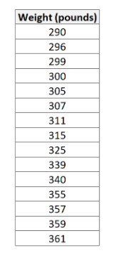
Observation and Variable

Slide 4
Observation and Variable
For example, a dataset with 100 rows has 100 observations.
It’s also interesting to note that a single observation can be associated with multiple variables. For example, in the following dataset there are 15 observations and 3 variables.

Slide 5
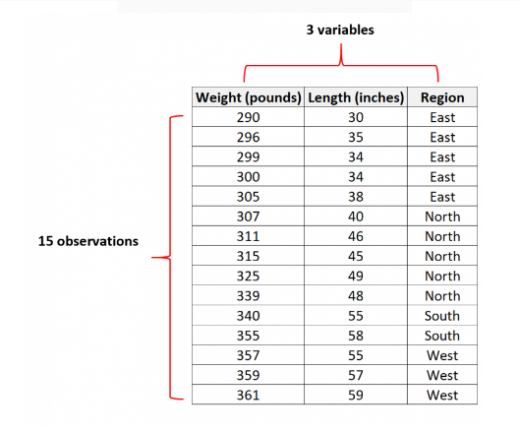
Observation and Variable

Slide 6
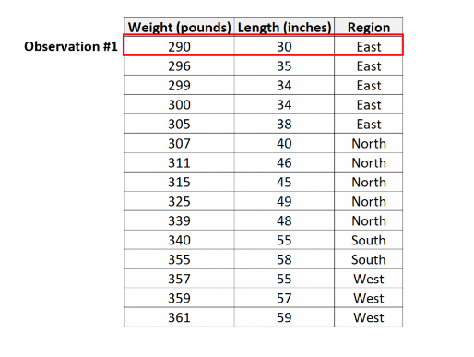
Observation and Variable

Slide 7
Observation and Variable
The first observation has the following values for the three variables:
Weight: 290 pounds, Length: 30 inches, Region: East

Slide 8
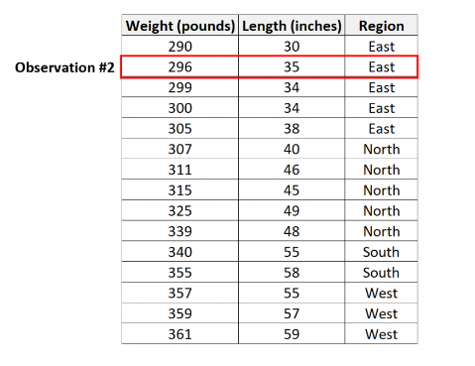
Observation and Variable

Slide 9
Observation and Variable
The second observation has the following values for the three variables:
Weight: 296 pounds, Length: 35 inches, Region: East.
And so on.
It’s also worth noting that the total number of observations is equal to the sample size of the dataset. For example, a dataset that has 100 observations has a sample size of 100.

Slide 10
Types of Variables
A variable is a characteristic or condition that can change or take on different values.
For example, if h is a variable representing height, you might use h1 and h2 to differentiate between the height of two different people.

Slide 11
What is Discrete Variables?
A discrete variable is a variable that takes on distinct, countable values. In theory, you should always be able to count the values of a discrete variable.
Examples
Examples of discrete variables include:
Years of schooling
Number of goals made in a soccer match

Slide 12
What is Discrete Variables?
Votes for a particular politician
Number of times a coin lands on heads after ten coin tosses.
All of these variables take a finite number of values that you can count. They are examples of discrete variables.

Slide 13
What is Continuous Variables?
A continuous variable is a variable that can take on any value within a range. A continuous variable takes on an infinite number of possible values within a given range.
Because the possible values for a continuous variable are infinite, we measure continuous variables (rather than count), often using a measuring device like a ruler or stopwatch. Continuous variables include all the fractional or decimal values within a range.

Slide 14
What is Continuous Variables?
Examples
Examples of continuous variables include:
The size of real estate lots in a country
The weight of baby elephants
The body temperature of patients with the flu
The deployment altitude of skydivers
None of these variables are countable. Each of them could take on an infinite number of values within a range.

Slide 15
Example
Discrete Variables
Continuous Variables
The number of workers in an office
The number of steps you take in a day
The number of babies born each day
The time it takes for office employees to commute to work
The distance you walk in a day
The weight of newborn babies

Slide 16
Error of Measurement

Slide 17
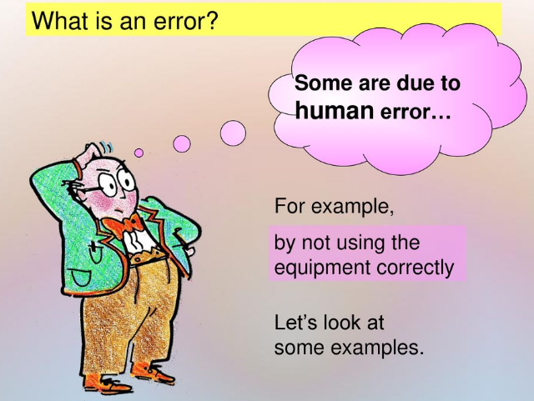

Slide 18
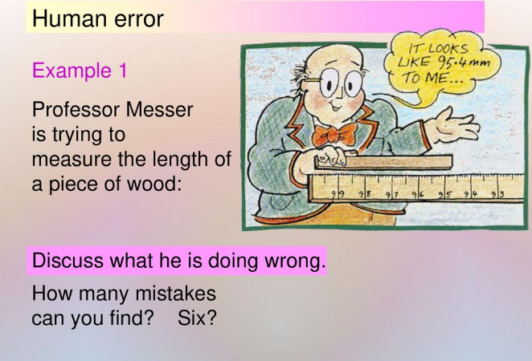

Slide 19
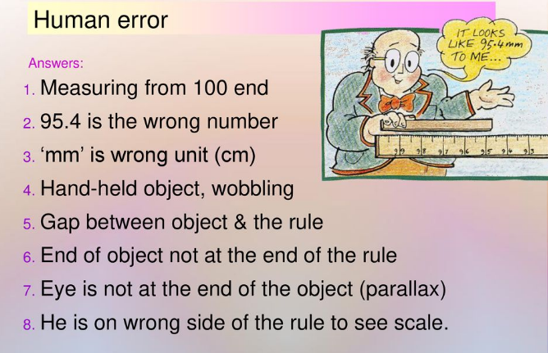

Slide 20
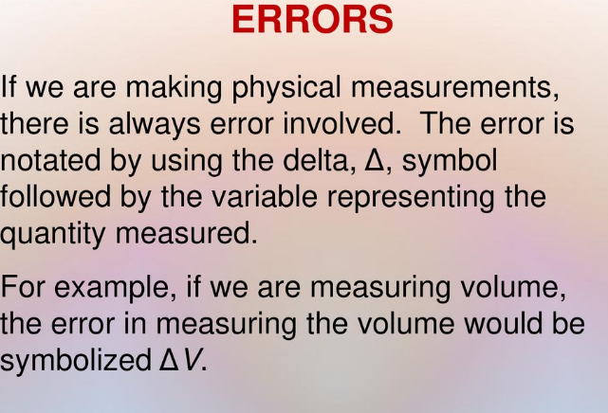

Slide 21
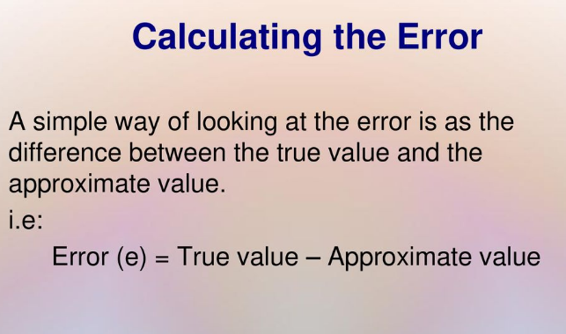

Slide 22
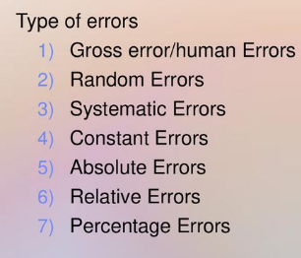
Types of Errors

Slide 23
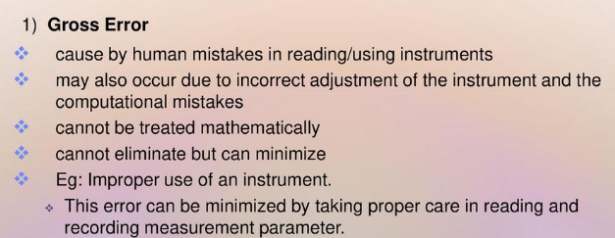
Types of Errors

Slide 24

Types of Errors

Slide 25
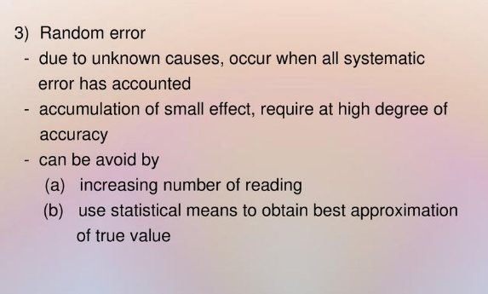
Types of Errors

Slide 26
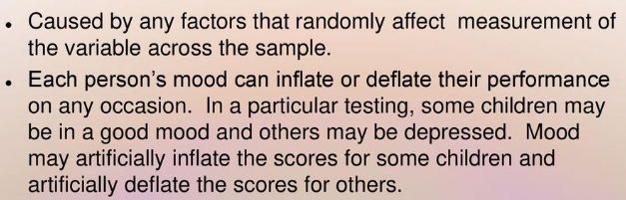
Random Errors

Slide 27
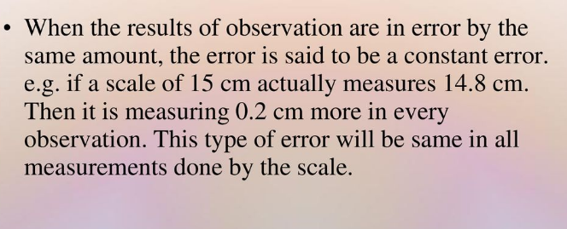
4. Constant Error

Slide 28
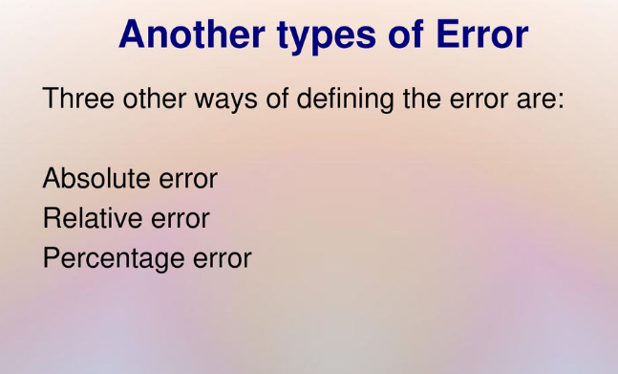

Slide 29
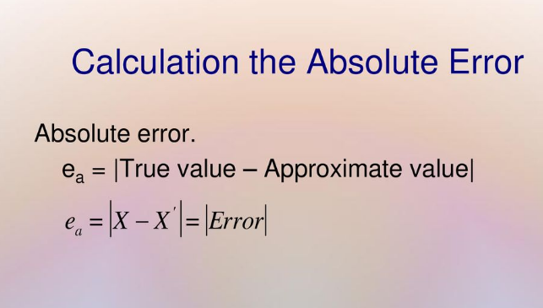

Slide 30
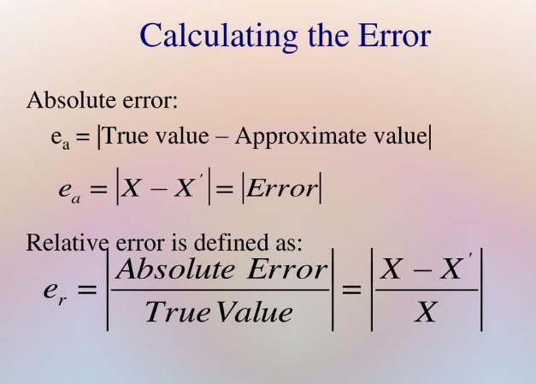

Slide 31
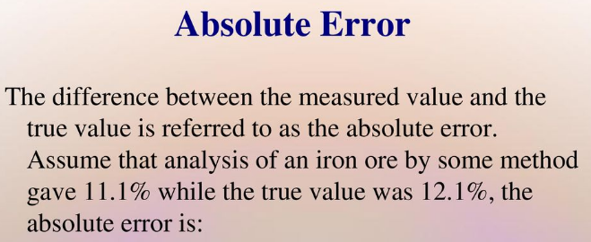
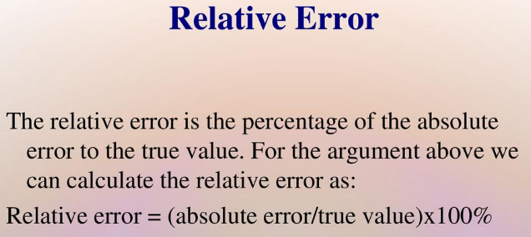

Slide 32
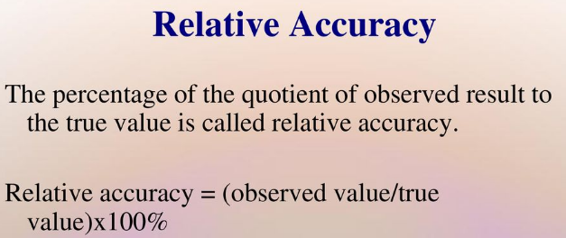
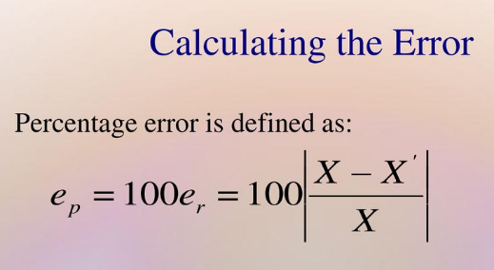

Slide 33
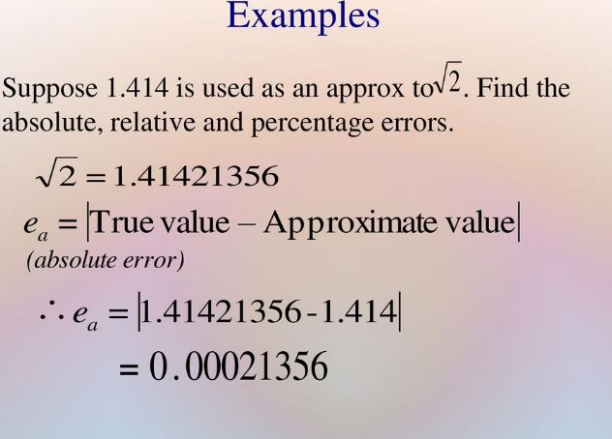

Slide 34
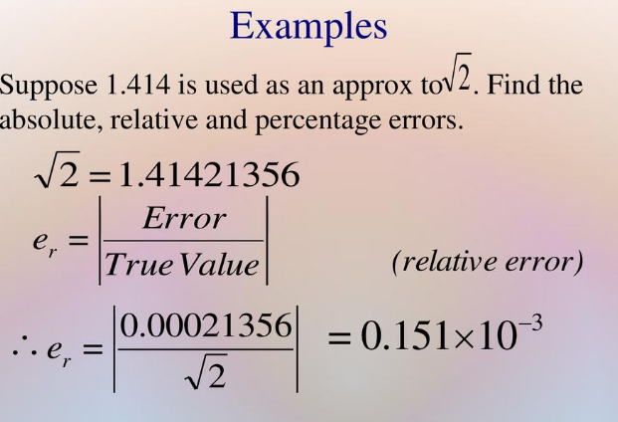

Slide 35
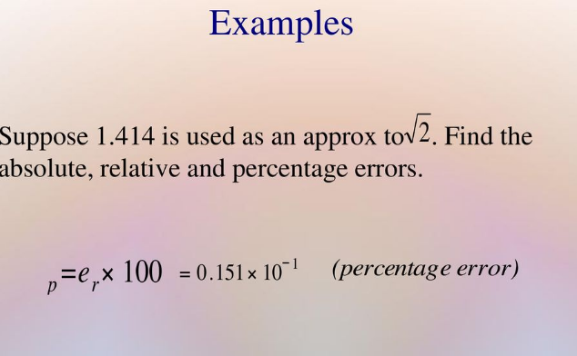

Slide 36
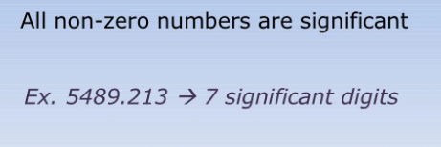
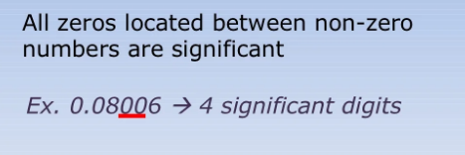
Significant Digits

Slide 37
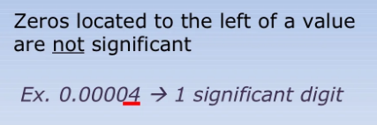
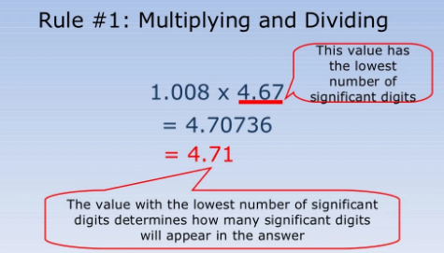
Significant Digits

Slide 38
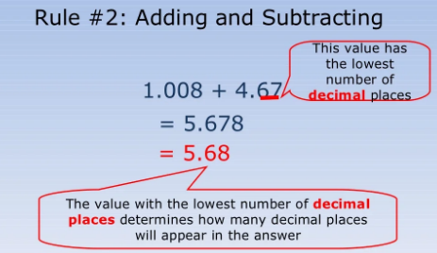
Significant Digits

Slide 39
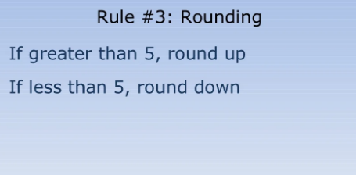
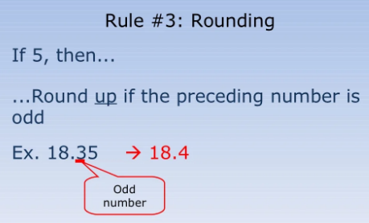
Significant Digits

Slide 40
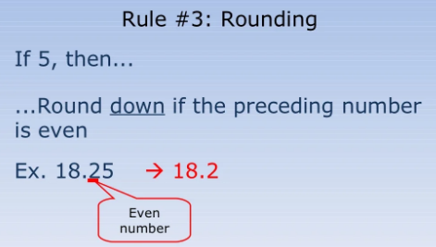
Significant Digits

Slide 41
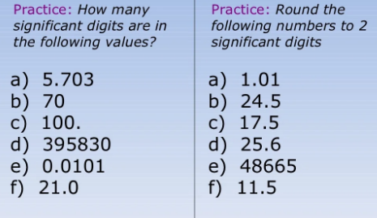
Significant Digits

Slide 42
Thank you!

